Slide 1


Careers in IT
John Bollen, CIO, The Cosmopolitan of Las Vegas
Alex Platt, Business Relationship Manager, Procore Technologies.

Slide 2
Agenda
What is Information Technology?
Types of Technology Careers
John & Alex Career Journeys
IT Organization Overview
Starting Out/Career Resources
Q&A

Slide 3

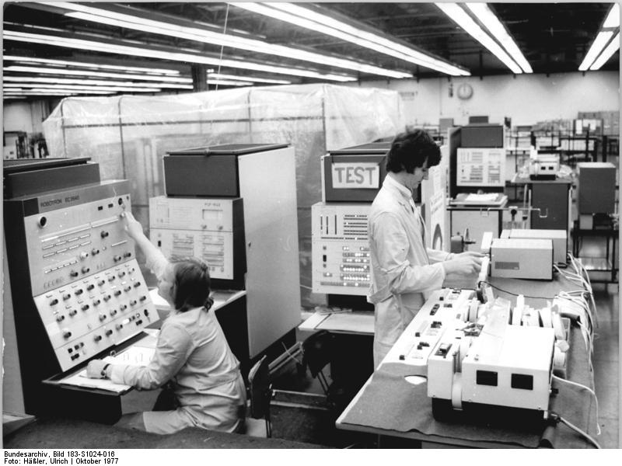

What is Information Technology?
Information Technology: The study or use of systems (especially computers and telecommunications) for storing, retrieving, and sending information.
Value Add: Technology ‘Automates’ an existing analogue process “to digital”!
Now information (data) is ‘digital’ and distributed via the “cloud / internet”
In the beginning - we put information on paper!
Then the information went in a Main Frame
Notes:
This would be the “history” of technology. It speaks to information moving from paper technology (a typewriter); to computers (old main frame); and then all Digital (the Cloud). During the whole process we automated how information was share from paper, to computer terminals access a mainframe, and now everywhere from the cloud on your own device.

Slide 4
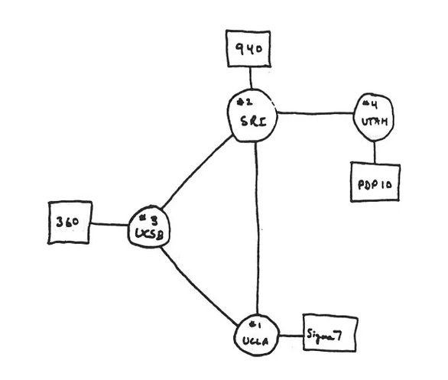
The Beginning of the Internet
1969 - 4 host - 50Kbps
Started at UCSB!
Notes:
Fun facts - it all started at UCSB!

Slide 5
Types of Technology Careers
Marketing Tech
Social Media
Digital Marketing
Data Analytics
CRM
Digital Editing - Photo / Video
Campaign / Offer Management
Technology Management
Security
Applications
Project Management
Engineering
Administration
Architecture
Management
Service Desk
Product Development
Product Manager
Tech Writer
Design Thinking
Analyst
UX Design
Engineering
Network
Server
Cloud
Data
Developer
Programmer
Architect
Security
Notes:
This evolution of sharing and communicating information via technology (Information Technology) led to new and exciting careers.

Slide 6





John Career Journey & Day in the Life
1st UC Website in Phelps Hall in former UCSB Micro Computer Lab
Technology Management - AAA Service Desk Manager and MBA @ USF
Technology Management - CityCenter Las Vegas Opening
1992
2000
2010
1995
2006
2014
1st ISP in San Francisco (Start Up) - great place for my 1st job.
Technology Management NBCUniversal - VP IT Studio Operations
Marketing Tech - Chief Digital Officer MGM Resorts International
Notes:
John Bollen’s path started at UCSB through different cities, industries, job types, and technologies.
Get involved where you can. I worked at the UCSB Micro Computer Lab
Start ups are fun! Great way to get a job and learn
Big company experience is good and continued education
Find “tech” that you like and follow it
Try new things

Slide 7




Alex Career Journey & Day in the Life
Intern + Summer Inn Manager: Data entry & database management
Program Associate:
Events, recruiting, digital comms, database migration
Talent Project Manager:
Foot in the door, jumped at system & data projects
2008
2014
2017
2012
2017
2021
Masters in Global Studies: Europe and South Africa, TEDxLSE logistics team
Program Associate (Temp): Production of All Gaucho Reunion, managed interns
Business Analyst → Manager, Talent Tech:
Process, systems, & data

Slide 8

IT Organization Overview
CIO
Business Solution
Security
Engineering
Data / Architecture
Services
297 Business Applications
Application Managers
Project Managers
System Analysts
Compliance
Threat Detection
Provisioning
Audit
Cyber Security
Severs
Internet
Network
Wi-Fi
Cloud
Data Base
Websites
Datamart
AI
Automation
Software Development
Data Lakes
Data Warehouse
Product Development
Service Desk
Asset Management
System Alerting
System Monitoring
Incident Management
Notes:
Today John manages several key Information Technologies in a integrated Casino Resort that impacts the Guest Experience

Slide 9
Starting Out/Career Resources
UCSB Courses
  101 Media Literacy
  116 Internet, Communication & Contemporary Society
  118 Communication Technology and Organization
  122 Organizational Communication
  160DS Special Topic: Data Science in Communication
  185 Communication Technology & Relationships
Free / Trial Resources
  Google Career Certifications (https://grow.google/certificates)
    Project Management
    IT Support
    UX Design
    Data Analytics
  FreeCodeCamps (https://www.freecodecamp.org)

