Slide 1

Research Facilities at the Department of Communication
UC Santa Barbara

Slide 2
Overview
The Communication Department operates two separate labs.
They are shared resources and are booked for individual research projects by different research teams through a centralized booking system.
All the furniture in the lab is portable and can be easily re-arranged.
The computers are updated regularly and serviced by the University.
Both labs are conveniently located, either in the same building as the Department or an adjacent building.
We also have a shared pool of ~1500 undergraduate research subjects who volunteer through their classes and are tracked by SONA.
See http://www.comm.ucsb.edu/research/support-facilities for details about all of our facilities.

Slide 3
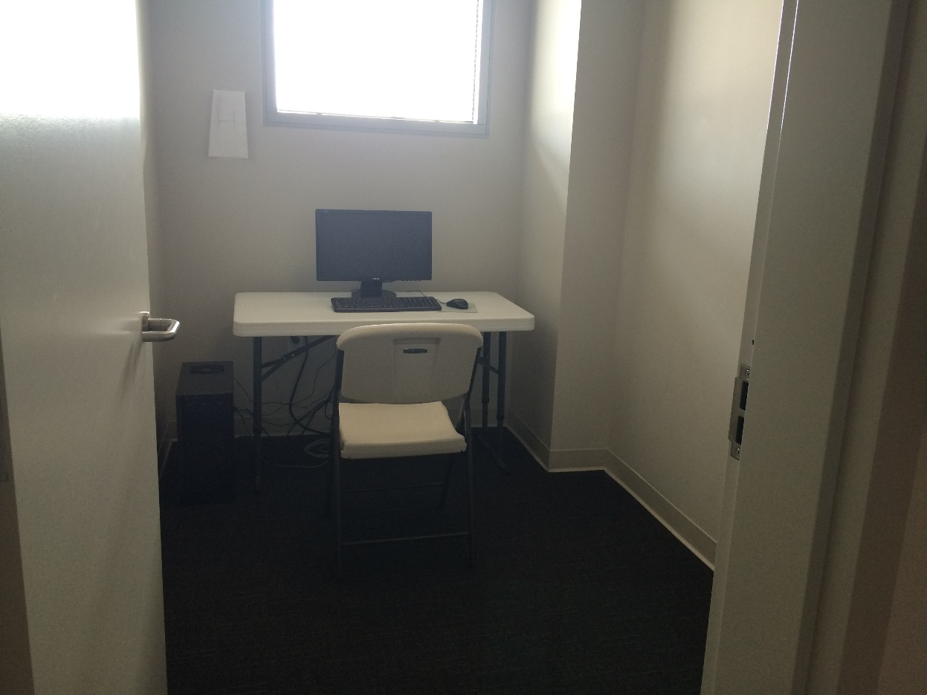
Research Lab #1: The SSMS Building
We have 7 individual “cubby” rooms for private individual surveys or one-on-one conversations
Each is equipped with a desktop computer, connected to the internet, and a desk and chair.
They are private rooms with a door.

Slide 4
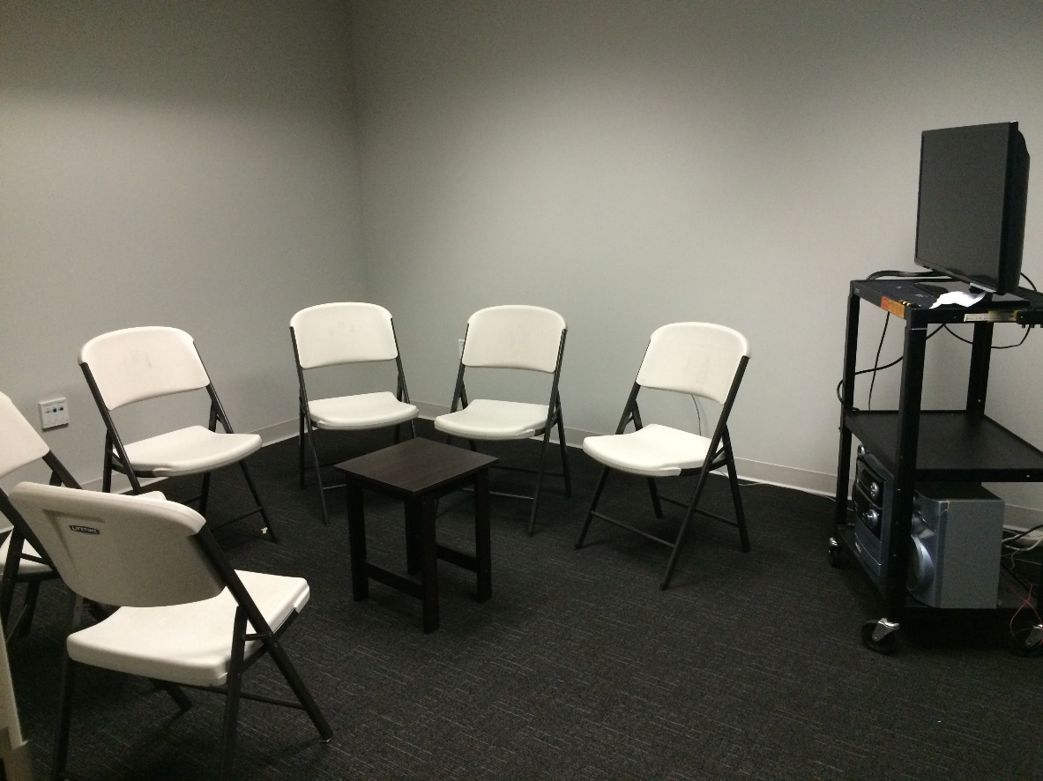
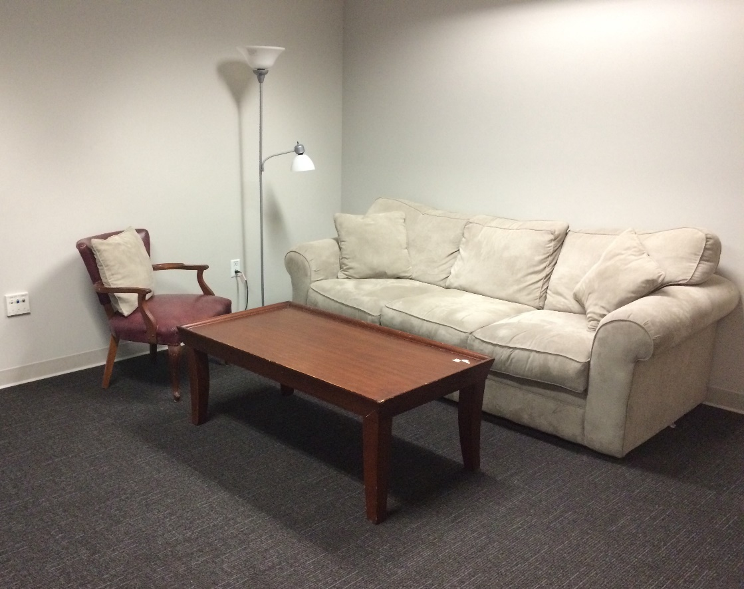
SSMS Lab: Two Interaction rooms
Focus Group Room
Monitor or TV can be used to show stimulus media.
Conversation Lab
Living room style for naturalistic family research.

Slide 5
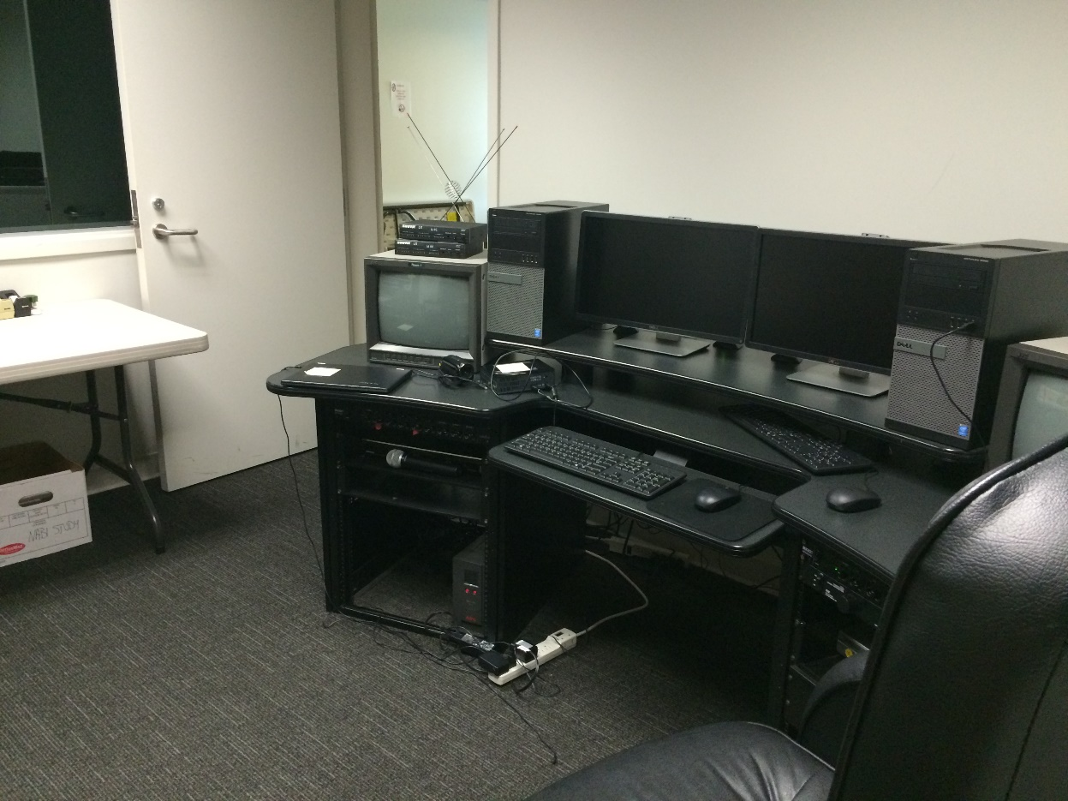
SSMS Lab: Interaction Rooms
Both interaction labs have one-way mirrors that are viewed from this “technology room”.
Both rooms are equipped with ceiling cameras and non-directional microphones. We also have tripod-mounted cameras for portability and additional camera angles.
Videos are captured on these desktop computers.

Slide 6
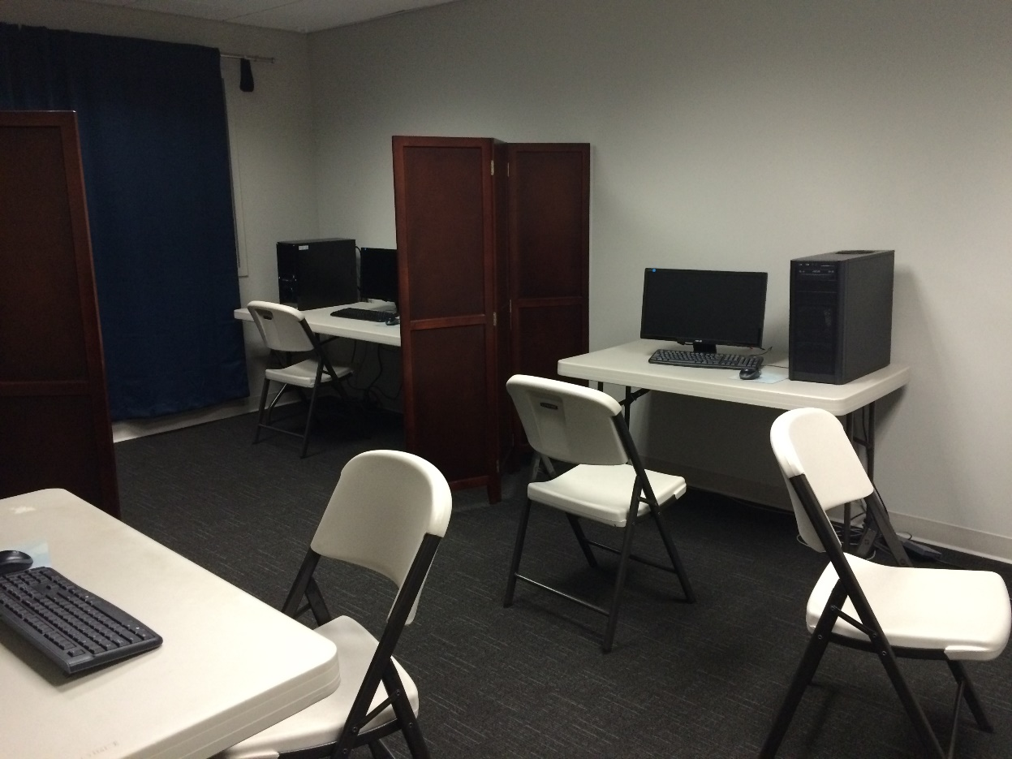
SSMS Lab: Survey Room
This lab is equipped with four additional computers for groups or separated with partitions for individual surveys.
The furniture is portable and can be easily re-arranged.

Slide 7
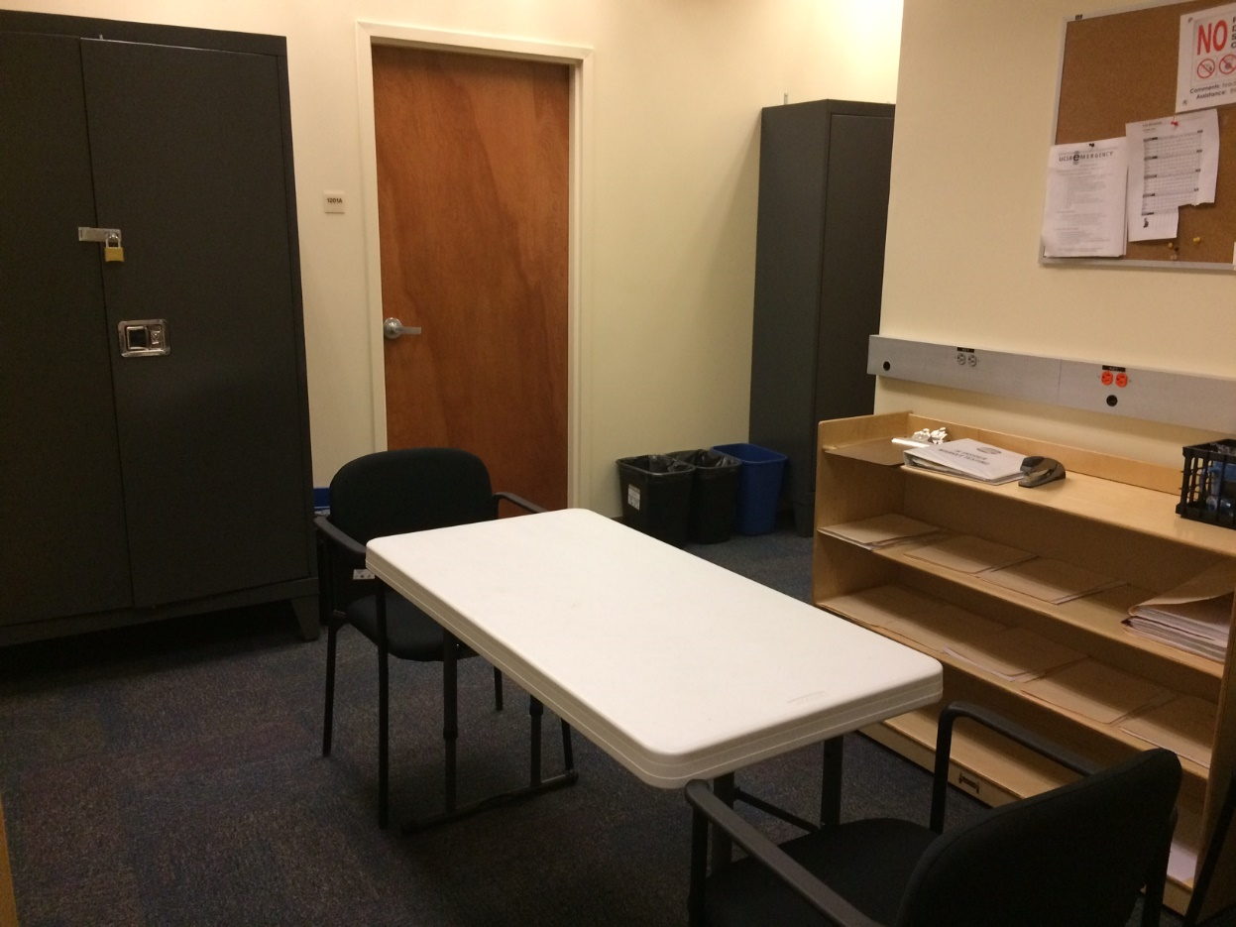
Research Lab #2: The HSSB Building
Research subjects are greeted at a welcome desk and sent to their appropriate rooms.
We have a large monitor on a rolling cart (not pictured) for showing media to subjects.
Large lockers store equipment and laptops. We have 12 laptops, additional cameras, headphones, and rolling cases to set up a mobile lab.

Slide 8
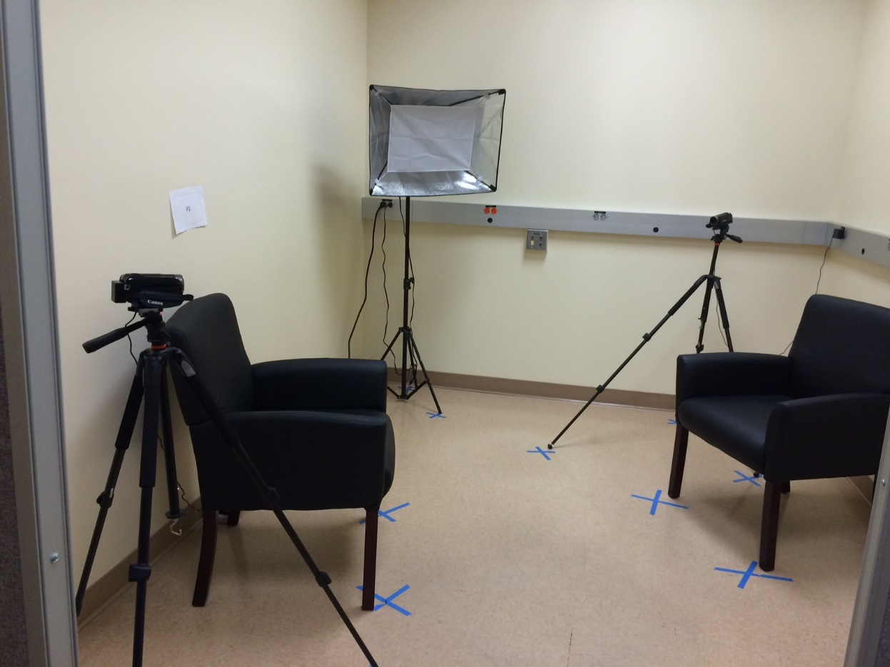
HSSB Lab: Dyadic interaction room
It is set up with professional studio lighting and portable cameras on tripods.
The lab is equipped with one desktop computer and portable furniture.

Slide 9
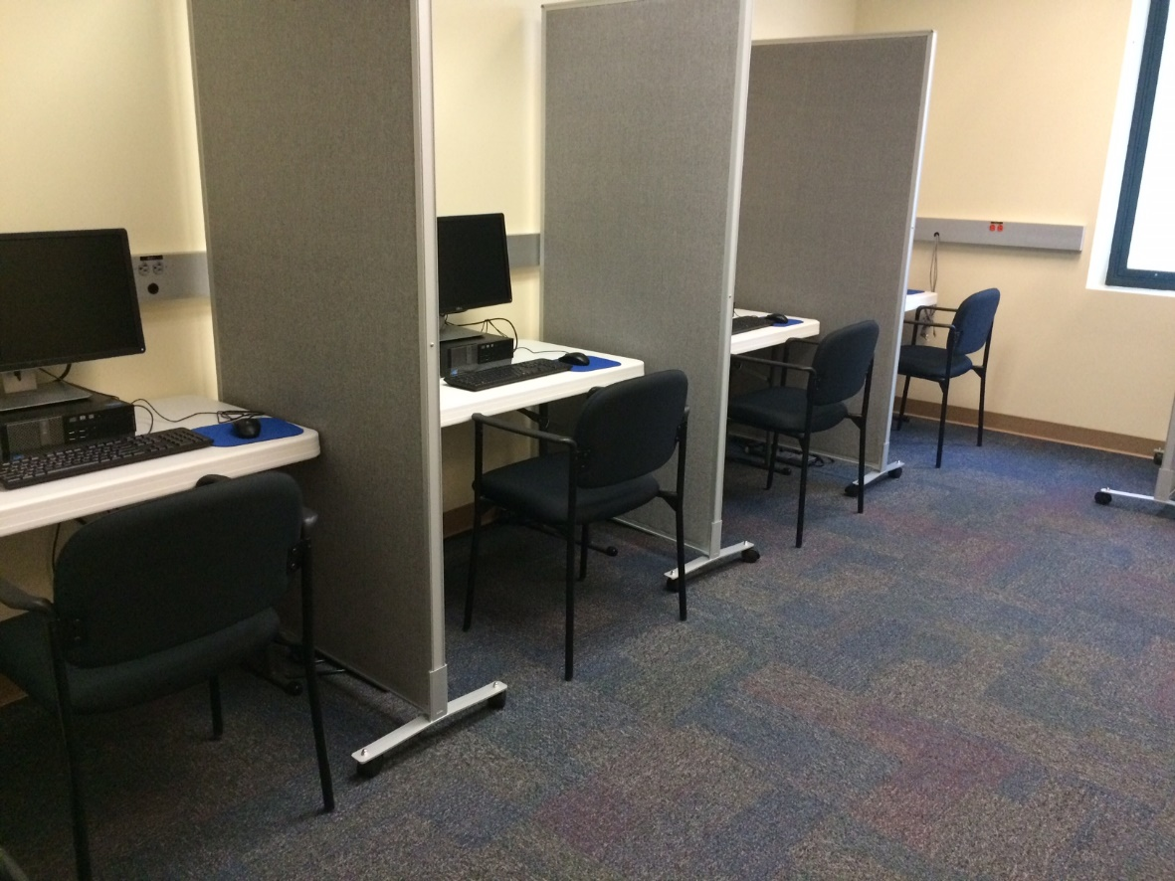
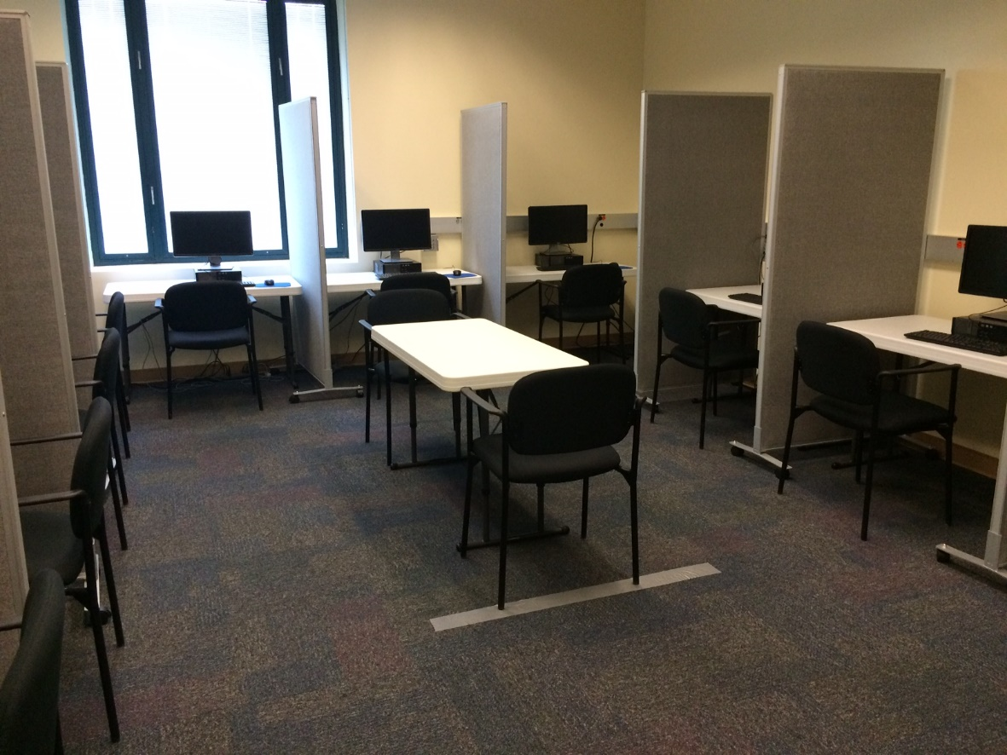
HSSB Lab: The survey rooms
Room 1: 9 computers with partitions.
Room 2: 10 computers with partitions.

