Slide 1
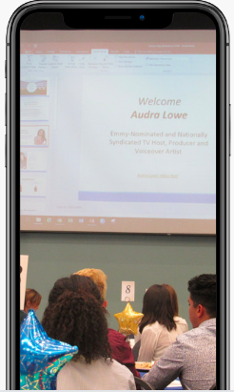
UCSB Comm Alumni Council presents
RSVP on Comm Dept Website: https://www.comm.ucsb.edu/alumni/involvement/resources
Monthly Virtual
Career Series
WE’VE TAKEN THE BEST OF CAREER DAY AND PUT IT IN A NEW LIVE ZOOM FORMAT
Join us for a live, 45 minute zoom session featuring UCSB Comm Alumni who will share their career journey, jobs in their industry and host a Q&A. Get inspired by learning about different careers using your comm degree.
January 13, 6pm PT: Careers in HR/Recruiting with Jamie Morgan, Head of Technical Recruiting, Cruise

Slide 2
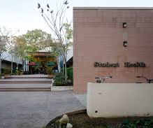

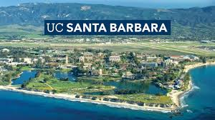
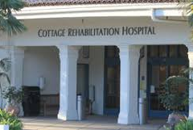





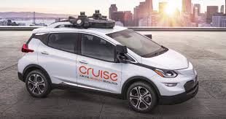
Jamie Morgan: My Career Journey

Slide 3
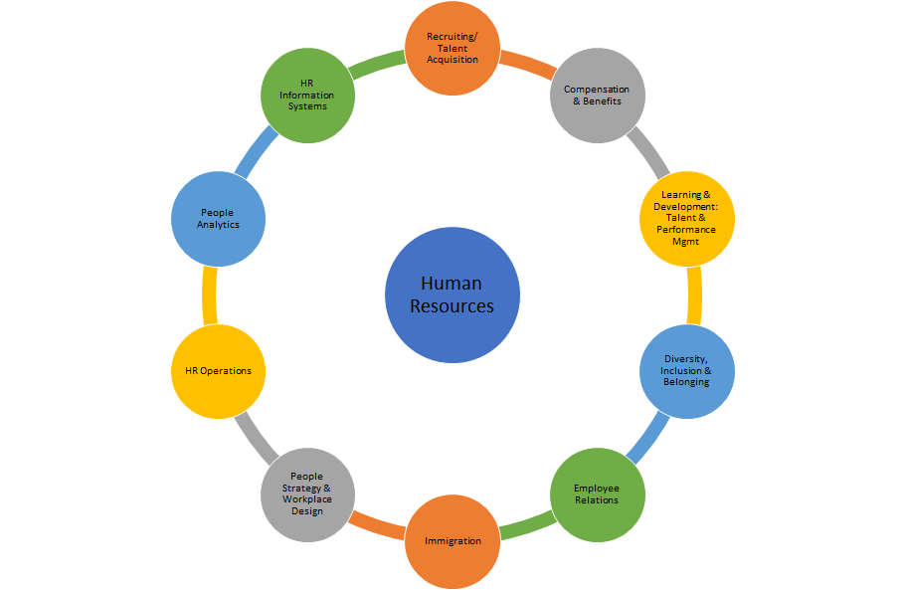
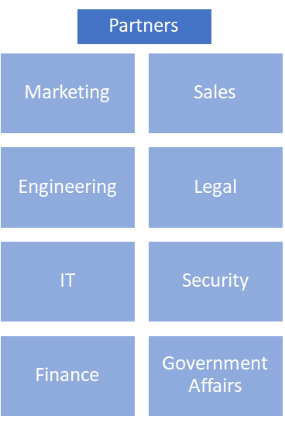
What is HR?

Slide 4
Recruitment / Talent Acquisition (TA)
Find Talent
Engage Talent
Evaluation & Selling to Talent
Offers
Training
Sourcing
Direct Outreach
Candidate Experience
Offer Creation
Connecting marketing and TA
Job Boards
LinkedIn
Storytelling / Marketing
Skills & Competency Based Assessment
Negotiation
Inclusive Interviewing Skills
Universities
Events
Company Sell &
Team Sell
Market Analysis
Behavioral Interviewing
Community Partnerships
Employee Referrals
Myth Busting & Tough Questions
Candidate Motivators
Validating Motivators

Slide 5
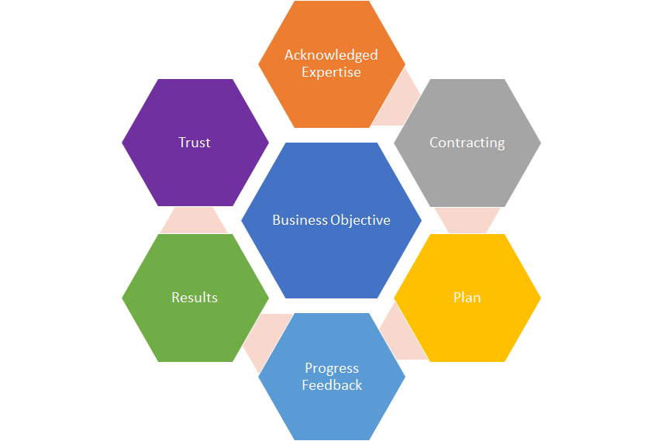

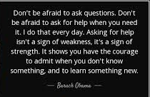
Lessons from Leadership

Slide 6

Click here for the full video presentation, and links to other Comm Alumni Council Virtual Career Sessions
https://www.comm.ucsb.edu/alumni/involvement/resources

