Slide 1
My Career Journey
Blend
Erin Bergamo-Tacy
ebtacy@gmail.com

Slide 2
UCSB
BA in Mass Communication
Alpha Phi Sorority
UCSB Rowing Team
UCSB Gymnastics Coach
Daily Nexus Sportswriter
Post Graduation:
Secured internship with NBC sportscaster
KNBR Sports Radio offer

Slide 3
Career Journey The First 5 Years
Stirling & Cohan Public Relations
What did I learn?
Office Management / Manufacturing / Public Relations
It’s not where you start, it’s where you finish
If you ask, people are willing to teach you
Figure out where you can add value
How to deal with good (and bad) managers
Understand when it’s time to move on

Slide 4
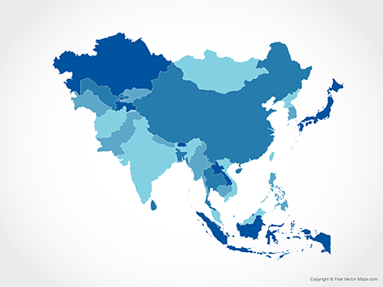
Career Journey The Next 20+ Years
What did I learn?
Broad Communications & Marketing
How to lead and manage a successful team
Volunteering for new projects leads to new opportunities
What it means to be global vs. a US multi-national
Don’t chase titles – seek opportunities that leverage your skills
If you can’t see your next opportunity at a company, it might be time for a change
Networking and company culture are critical to your success

Slide 5
Blend Labs, Inc. Powering the future of banking
Chief Communications Officer
Interim Chief Marketing Officer
Comms
Public Relations
Analyst Relations
Executive Comms
Internal Comms
Social Media
Crisis Comms
Marketing
Brand
Demand Gen
Event Marketing
Product Marketing
Field Marketing
Digital Marketing

Slide 6
Questions?

Slide 7
Thank you

