Slide 1

The Evolution of a Career
How A Communication Degree Can Allow
You to Pivot throughout Your Career
Tom Bracken
Managing Director
SunRock Media and Marketing

Slide 2
My Journey – Quick Summary
Completed my BA in Comm Studies in 1977
Accepted a TV production summer internship at KNBC
  Hired onto show following internship
Returned to UCSB to begin Masters Degree in 1978, earning degree in 1980
  Thesis was on effectiveness of video within a corporate setting
Launched my career beginning in Corporate Video
Pivoted throughout my career in the following roles:
  Corporate Video Manager
  Marketing Proposal Manager
  PR Manager
  Sr Manager Communications - PR and Advertising
  Director/VP Marketing Communications and Advertising
  VP Marketing
  Global VP Marketing and Communications
  Managing Director

Slide 3
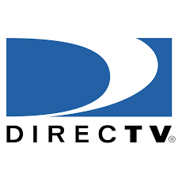




Industry Diversity
Communications roles are needed in virtually every industry
Industries I have worked in include:
  Aerospace/Defense
  Commercial Satellite Communications
  Pay TV – founding team member of DIRECTV
  Green Energy – Utility Company
  Cable TV
  Entertainment Services (Post production/Visual effects)
  Entertainment Distribution
  Broadband Services
Industries provided marketing consulting services:
  Broadband company – selling high speed internet
  Advertising technology
  Gaming company
  Digital equipment hardware company
  Real Estate
  Online TV distribution start ups

Slide 4
Getting Practical Experience in a Theoretical Education
While at UCSB, I started to think about what I would do next. How could I get some real world, practical experience or exposure to a field of interest
Needed additional units to graduate. Worked with a professor and created an Independent Study class that would require connecting with TV producers and industry personnel
  No connections in the industry so required letter writing and cold calling to get interviews for the project
  Following one interview, the Exec Producer offered me a Summer internship
Masters Thesis
  Started off wanting to do a theoretical piece on children’s television. But after beginning the work, discovered it was a saturated field of study and wouldn’t help me land a job.
  Pivoted to a relatively new area - corporate video
  Conducted an corporate video effectiveness study with a major international airline
  Had unique and demonstrable experience when seeking my first job out of grad school

Slide 5
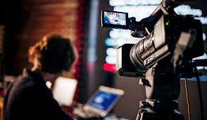
Transitioning from Corporate Video to Marketing, Advertising & PR
Corporate video was all about creating video marketing and communications programs for selling, informing, educating, promoting (PR)
  Audiences were customers, employees and general public
Role involved many basic communication skills:
  Identifying and understanding the target audience
  Writing scripts
  Creating visuals and video storyline to deliver impact
  Managing budgets, people, schedules, deadlines
  Creating support materials – brochures, proposals, etc.
If I can write a script, I can write a press release or develop and manage an ad campaign

Slide 6

First Pivot
Evolving from Corporate Video to PR Manager
Think about what you do in your current job and how those skills might apply to your next job

Slide 7
Building and Expanding My Role
Continued using the same evaluation and expansion process
At DIRECTV, started as Sr. Manager of Communications and chief spokesperson but quickly advanced to VP Advertising and Marketing
Advertising/Branding Managed agencies; defined corporate goals: defined audiences; managed budgets
Strategic PR
DC Lobbying; Managed Messaging; Writing Executive testimony
Marketing Communications
Creating sales materials for National Retailers (BestBuy, Walmart, Costco)

Slide 8
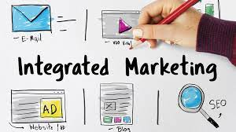
Further Career Evolution: Managing A Fully Integrated Marketing Department
Aspired to and ended up managing global integrated marketing departments (3 different companies)
Disciplines within the department
  PR and Industry Relations (may include government lobbying)
  Acquisition Marketing (getting new customers)
  Retention Marketing (keeping existing customers – selling them more)
  Digital/Social Media
  Website Marketing
  Advertising/Branding
  Internal Communications
  Event Planning/Customer Relationship Management/Trade Shows
  Marketing Communications (creating support materials/sales sheets, etc.)

Slide 9
Key Tactics for Pivoting
Believe in yourself and your skillset
Have a vision for your next role
Be risk averse – don’t be afraid to step outside your comfort zone
  Former boss said I was making a mistake joining DIRECTV and don’t expect to have my job back if it fails
Find the similarities between what you do now and the requirements of the next job
  DIRECTV to Green Energy
Internships are a great way to start – paid or unpaid
Informational interviews
  Ask for referrals of other people that might be worth talking to
Networking – constant and continual throughout your career, not just when you need help finding a new job
  Denver transition experience

Slide 10
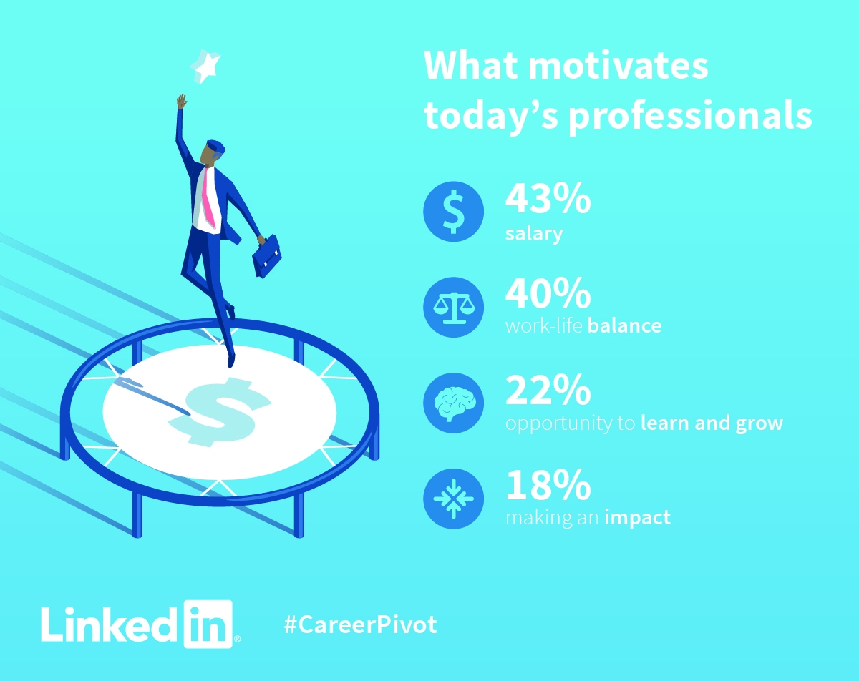
Timing Considerations – When to Pivot
Growth in current position is limited
Have a strong sense you are ready to do more in your career
  Bored, frustrated, not being challenged
Want to make more money
Recruiter contact

Slide 11
Versatility of a Communications Degree
Comm Degree provides you with the skills that can be applied in many different ways
  PR
  Advertising
  Marketing
  Law School or Legal Industry (i.e., jury consultant)
  Politics or non-profits
Communication skills are needed in virtually every industry
Enables you to pivot throughout your career
Provides a rich and rewarding career path that will keep you you intrigued, motivated, challenged and inspired

Slide 12
Thank you
Q & A

