Slide 1
Claire Knowles
Marketing Communications (MarCom) Manager
Infineon Technologies

Slide 2
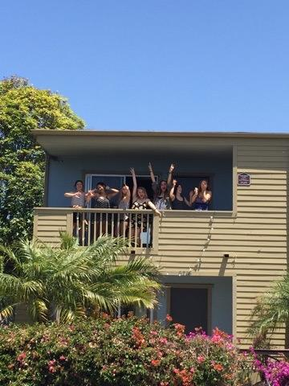
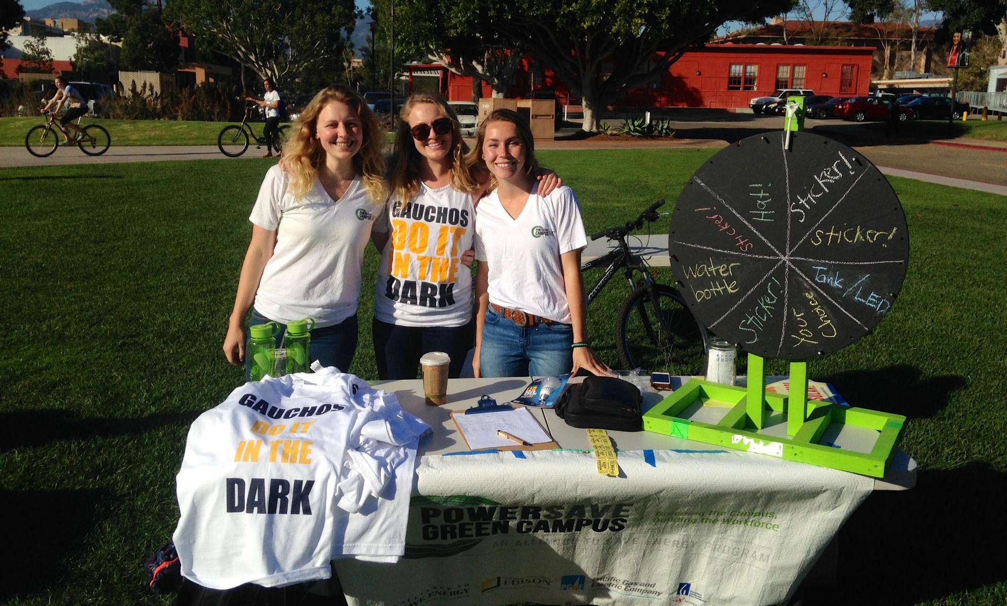
My Time @ UCSB
Graduated in 2015 with B.A.s in Communication & Global Studies
Spent my junior year in South America
Team Manager of UCSB’s PowerSave Campus Program
Did summer internships in:
Sports Marketing
Journalism
Global Marketing Communications

Slide 3
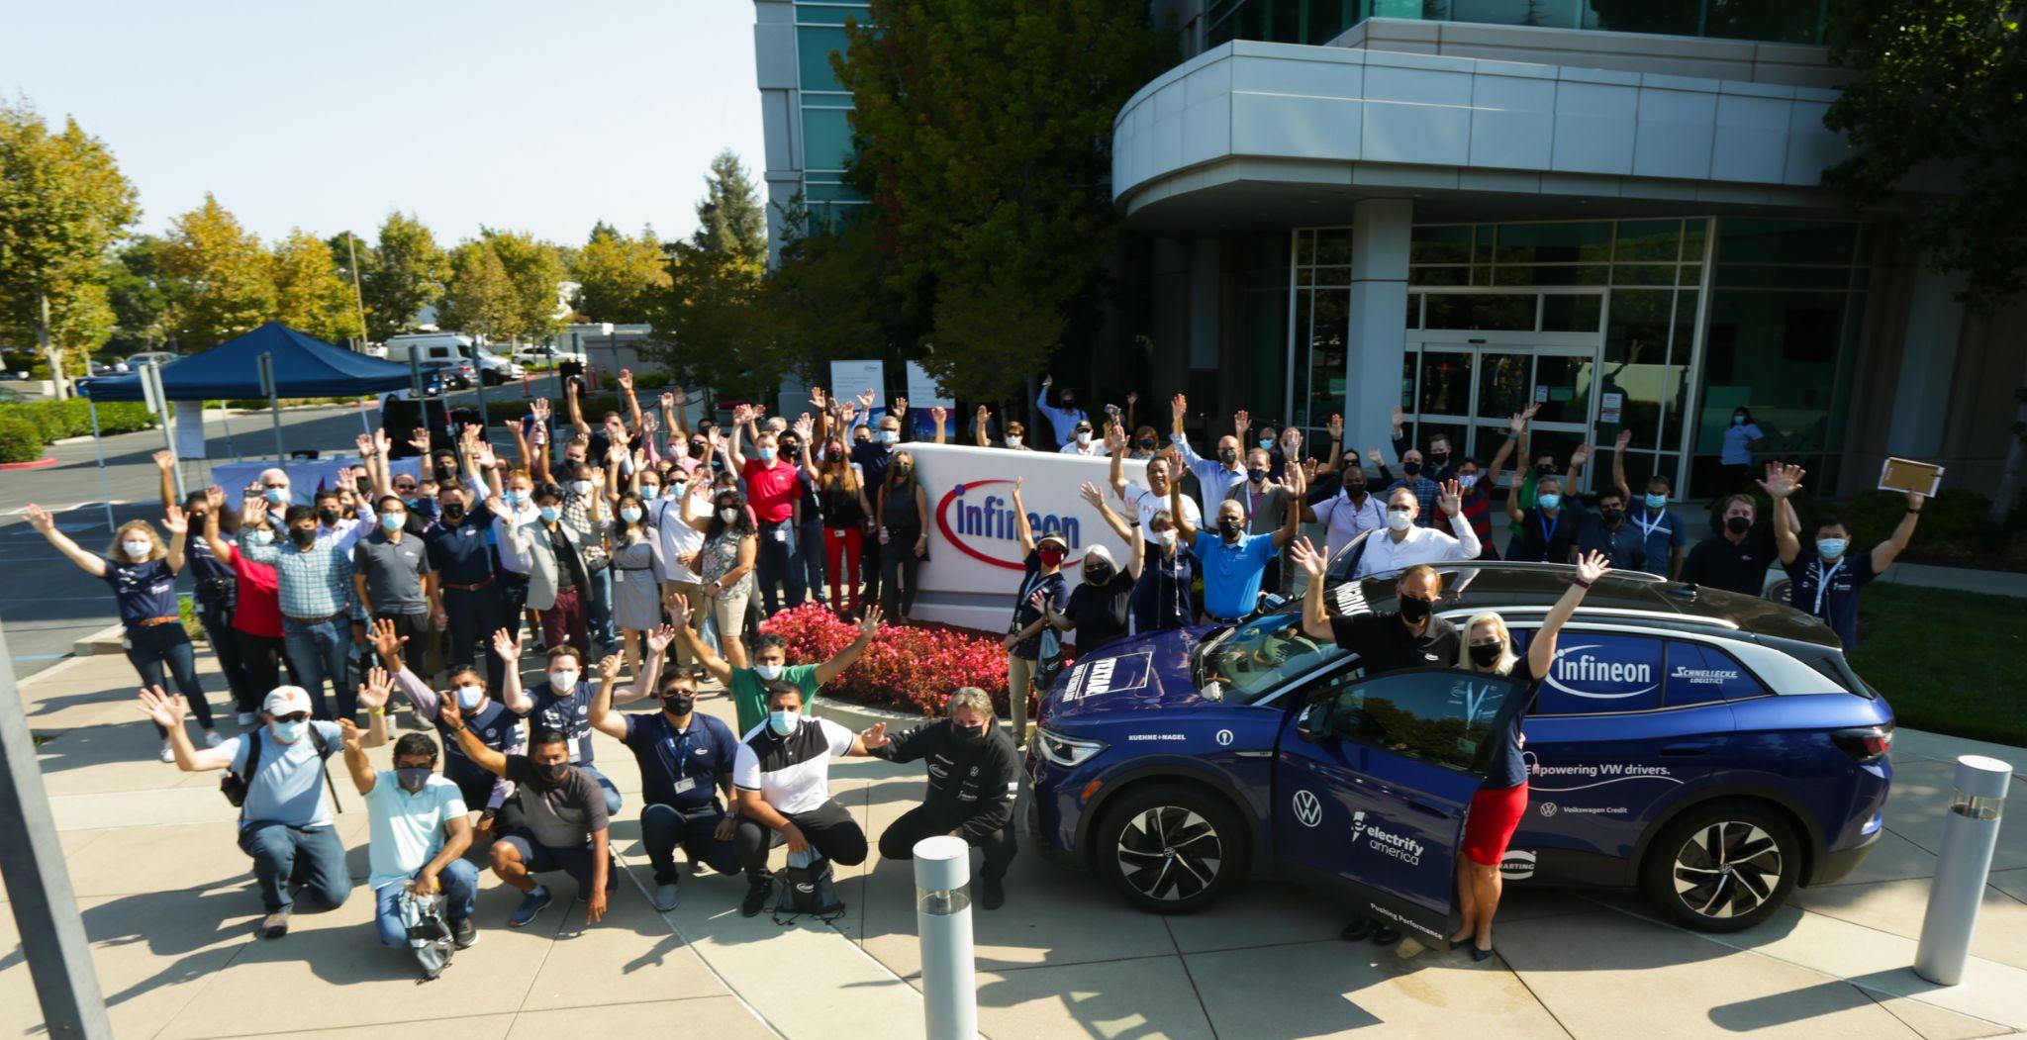

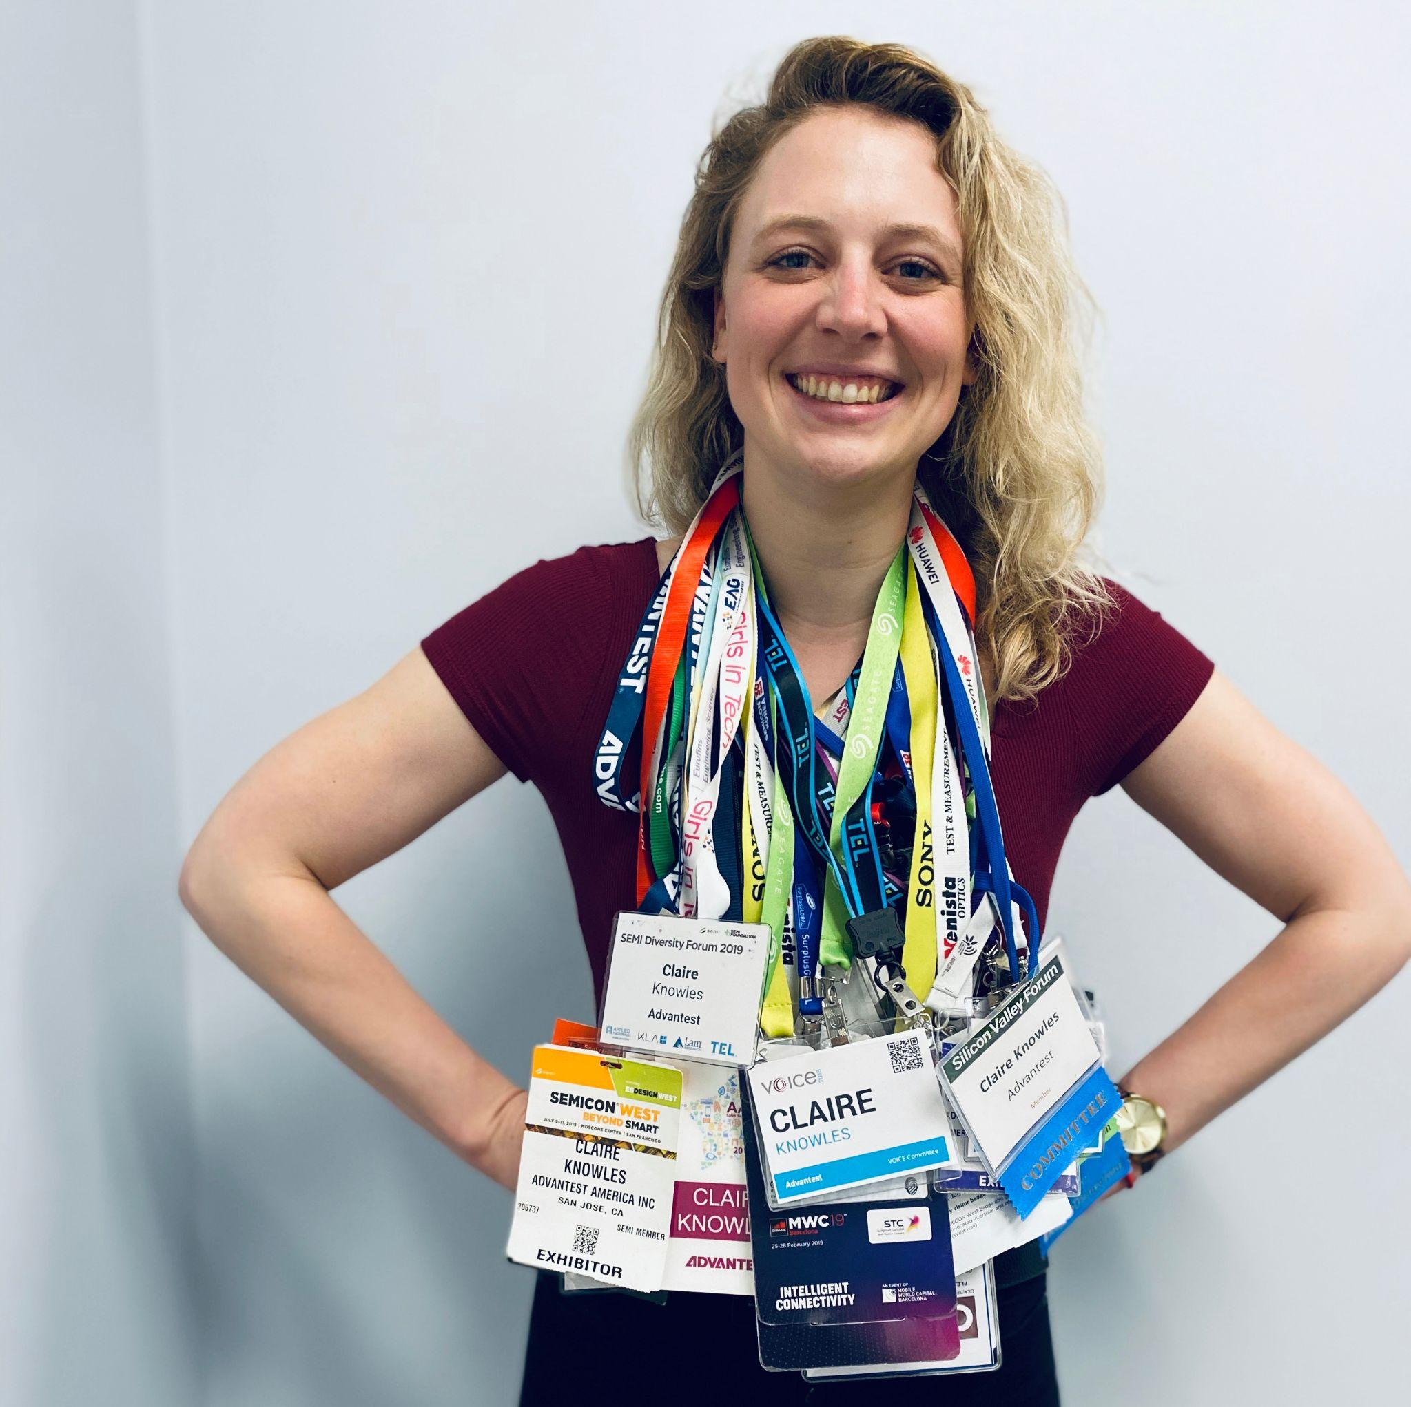
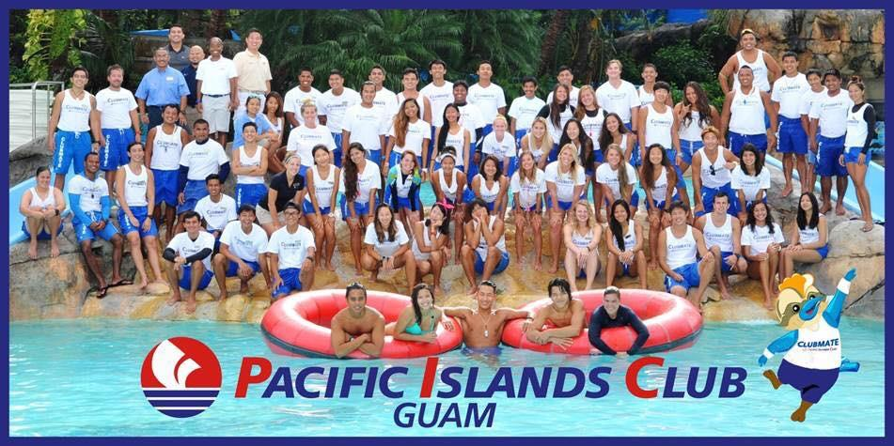
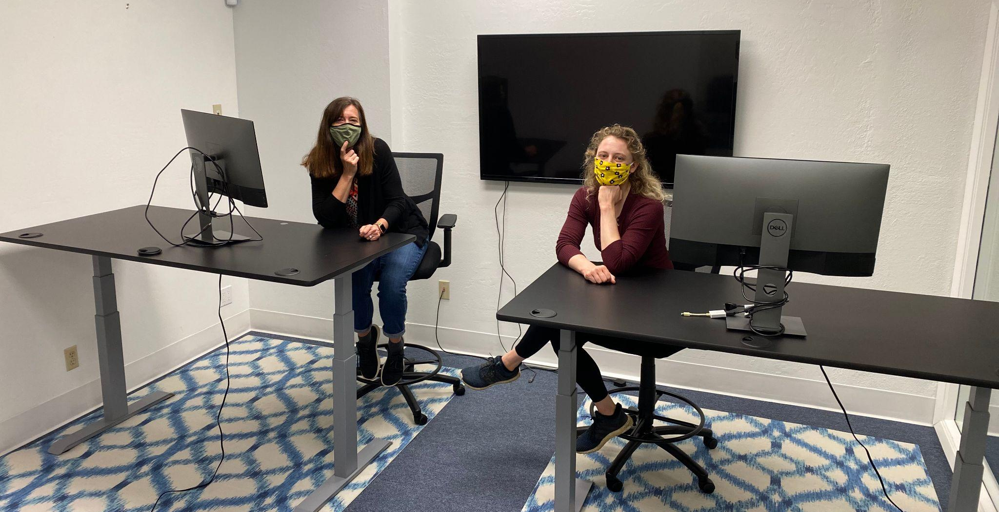
What Happened Next?

Slide 4

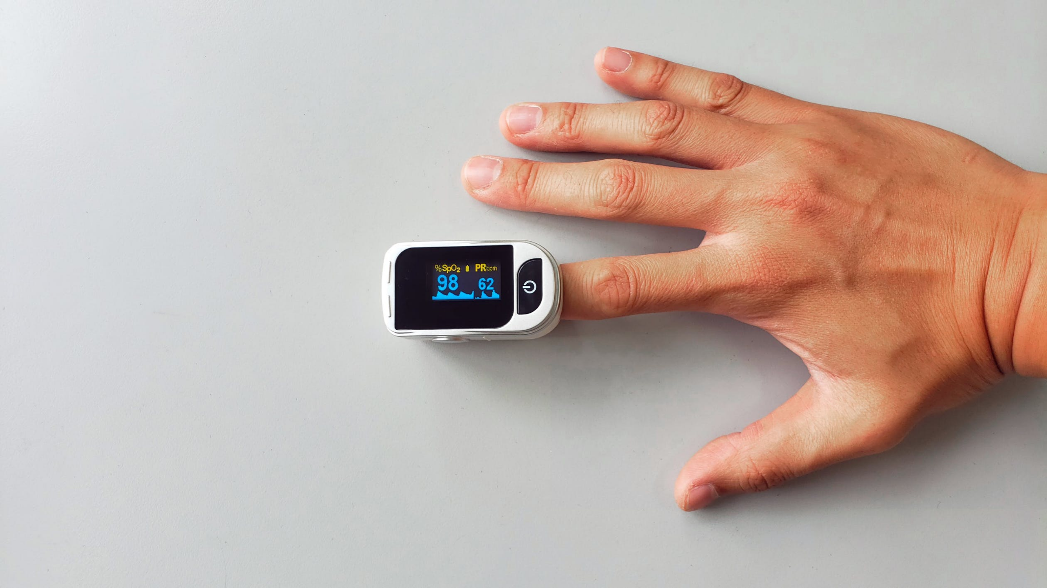
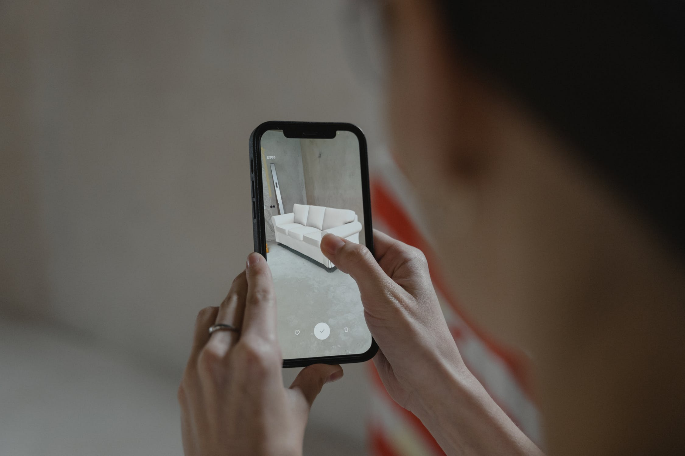


What is a Semiconductor?
A semiconductor is a material that has certain unique properties in the way it reacts to electrical current.
While a semiconductor is not an invention and no one invented the semiconductor, there are many inventions that are semiconductor devices. The discovery of semiconductor materials allowed for tremendous and important advancements in the field of electronics. We needed semiconductors for the miniaturization of computers and computer parts. Semiconductors are employed in the manufacture of various kinds of electronic devices.

Slide 5

What is Marketing?
“Marketing refers to any actions a company takes to attract an audience to the company's product or services through high-quality messaging. Marketing aims to deliver standalone value for prospects and consumers through content, with the long-term goal of demonstrating product value, strengthening brand loyalty, and ultimately increasing sales.”*
*Definition from Hubspot

Slide 6
What I Do as a MarCom Manager
Production Management
Campaign Strategy
Promotions Development
Tradeshow/Event Planning & Execution
Brand Management
Budgeting & Analytics
Swag Orders
Content Creation
  Graphic/content development for social media and online publications
Copywriting
  Blogs, Executive Communications, Press Releases, Social Media Posts
Editing
Web Development
  Promo page creation and edits
  SEO

Slide 7
Questions?

Slide 8
Words of Advice When Looking for a Job
DM people on LinkedIn with jobs you’re interested in
Your first job doesn’t have to be your dream job, but it should provide you with a step to where you want to go (or bring you joy)
Network with anyone--including your parents, their friends, friends of your friends, etc.
While job hunting, focus on growing the skills you want to use professionally
Leverage skills you have that might not have come from prior work experience
(ex. social media, writing, graphic design, leadership)
Example of how I spun my time on Guam
“...supervised up to 15 employees at a time in the Sports, Entertainment and Activities department at the Pacific Islands Club Resort on Guam. Honed valuable professional attributes including patience, teamwork, adaptability and leadership. Interacted with people from diverse backgrounds and a variety of countries.”

Slide 9
Words of Advice for Your First Job
Say yes to everything (within reason)
Ask to be added to projects you’re interested in
Take initiative and research opportunities
Find a mentor
Have annual, biannual, or quarterly check-ins with your boss to discuss performance and areas/opportunities for growth
Advocate for yourself

Slide 10
Keep in touch
Claire.Knowles@infineon.com
https://www.linkedin.com/in/claireoknowles/

