Slide 1

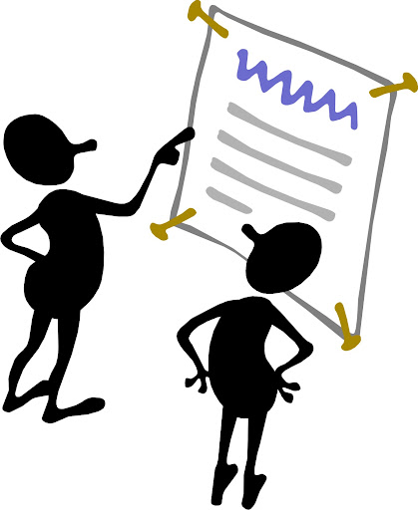

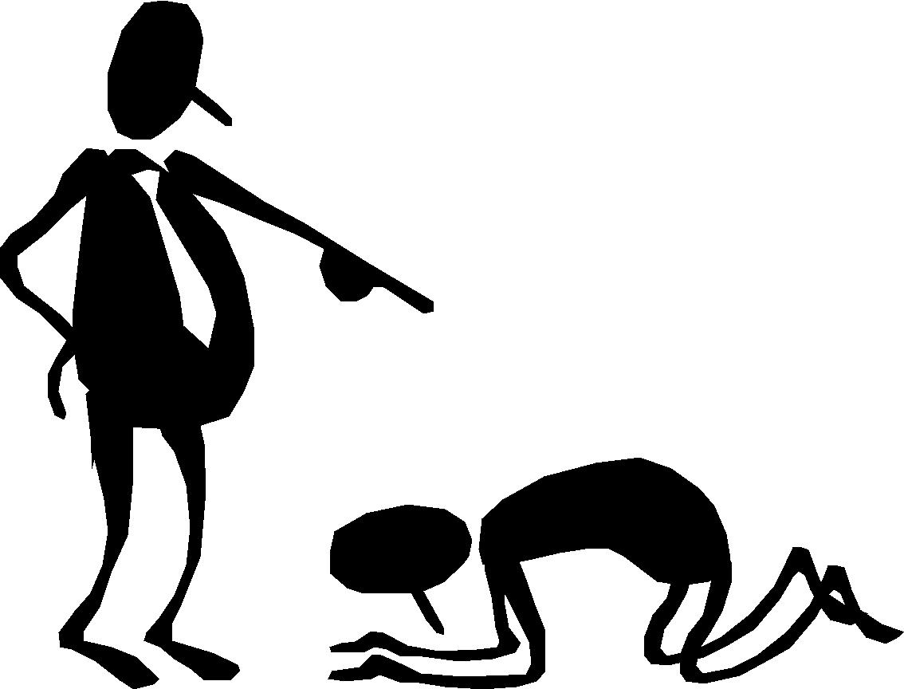
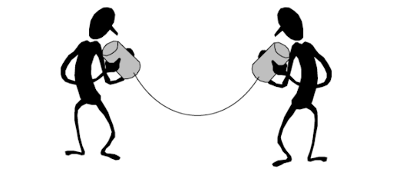
What is deception?
Knowingly causing someone to believe something that is false.
Facial Expressions
Verbal Statements/ Linguistics
Physiological Responses
Body Posture & Gestures
Vocalics/ Paralanguage
Notes:
Facial expressions: The easiest thing to control. People often think you can detect deception in the eyes or face but in reality it is the worst place to look.
Physiological responses: This is what the polygraph is looking for, things like heart rate and sweating. People also look for blinking or reaction time as a measure.
Body posture and gestures: Liars actually use fewer gestures than truth-tellers. They look down and try not to give anything away. They are often more submissive and try not to dominate but that varies by the type of lies
Verbal statements or linguistics: Take less ownership of what they are saying, more uncertainty, fewer 1st person pronouns.
Vocalics: More uncertainty, less dominance and confidence, more pauses, signs of cognitive load.
Important to look at all of it. Not just 1 cue because you have to give deceivers too many things to think about. If you look for just 1 clue like eye contact, you will be fooled.

Slide 2
Detecting Deception & Financial Crime
  Money Laundering Definition - Money laundering involves disguising financial assets so they can be used without detection of the illegal activity that produced them. Through money laundering, the criminal transforms the monetary proceeds derived from criminal activity into funds with an apparently legal source.
  Customer Due Diligence – Deception in Account opening
  Transaction Monitoring – Activity that does not fit business or occupation
  False claims about sources and uses

Slide 3
Careers
  Financial Crime Careers
    Financial Institutions – Banks, Credit Unions, Money Services Businesses, Payment Processors, FinTech & Crypto Currency, Securities
    Investigations
    Program Management & Risk Assessment
    Data Analysis
  Law Enforcement – FBI, IRS Criminal Investigations

Slide 4
Resources
UCSB data science initiative: https://datascience.ucsb.edu/
Website for the National Center for Credibility Assessment:
https://www.dcsa.mil/mc/tec/ncca/
Certifications in the financial crimes industry
https://www.acams.org/
https://www.icba.org/.../pro.../bsa-aml-certification-(cbap)
https://www.aba.com/.../certified-aml-and-fraud-professional
About AML RightSource: https://www.amlrightsource.com/

