Slide 1
UCSB Comm Alumni Council Virtual Career Session
Presentation:
‘Careers in Public Relations’
Debbie Fitzgerald
May 26, 2021

Slide 2
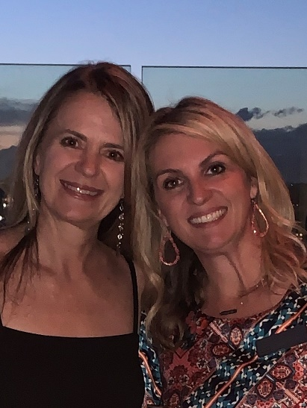
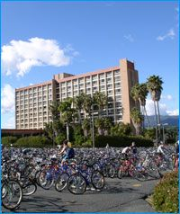
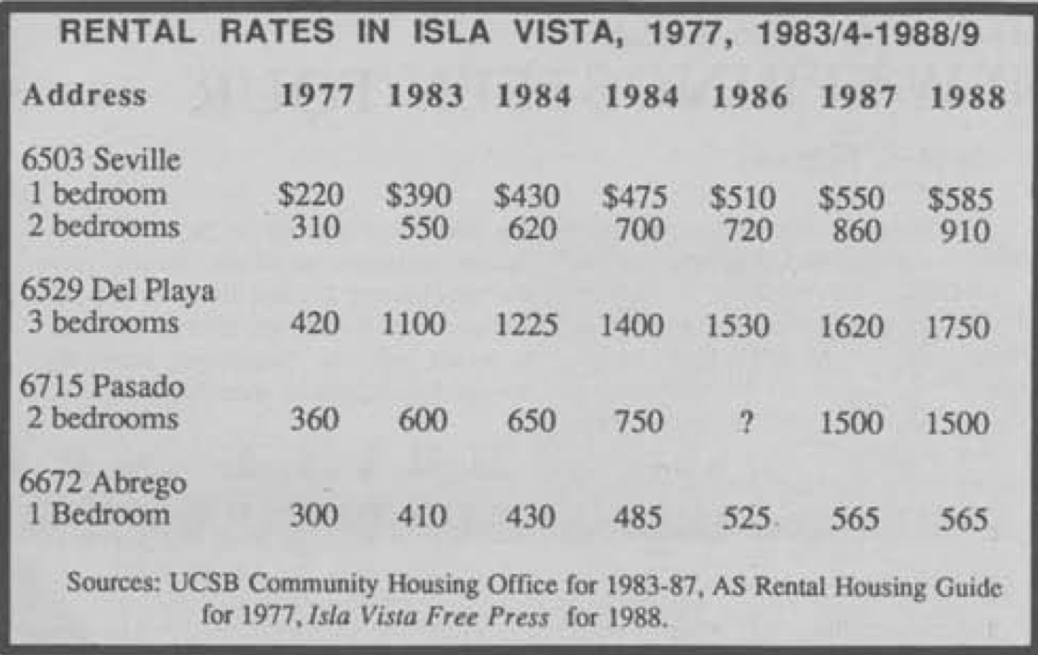
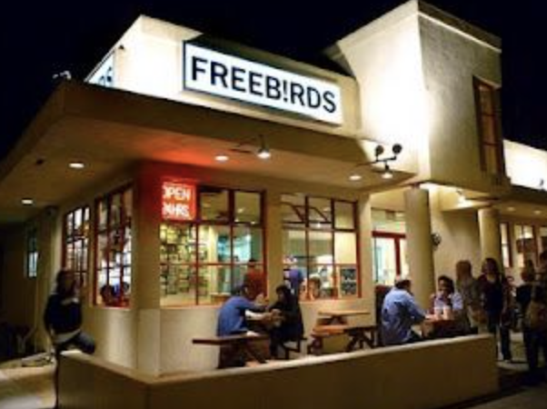
Debbie Fitzgerald: ½ of ‘Fitzgerald Petersen Communications’
Who are you?
1992 Graduate
BA, Communication

Slide 3
How did you get here?
EGO
HIT
As many internships and entry level jobs as POSSIBLE!

Slide 4
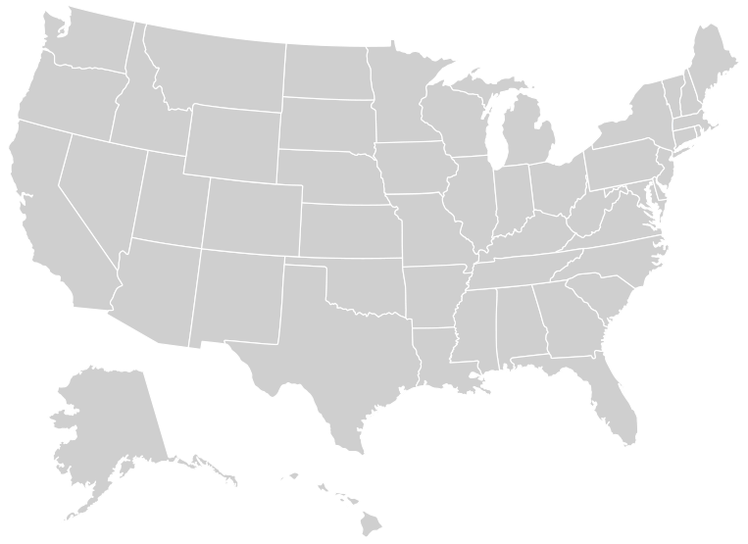
Footprint

Slide 5
Big Agency Senior Leadership with Boutique Attention!
The FPC Difference: We offer the expertise of a big name agency with the attention to detail and the ownership that comes from a personal approach. With our firm, you get a public relations partner with senior experience, stellar results, flexibility, a sense of urgency, financial sensitivity, ownership of engagement and passionate enthusiasm!

Slide 6
Big Brand Experience, Boutique Approach

Slide 7
Current Clients

Slide 8
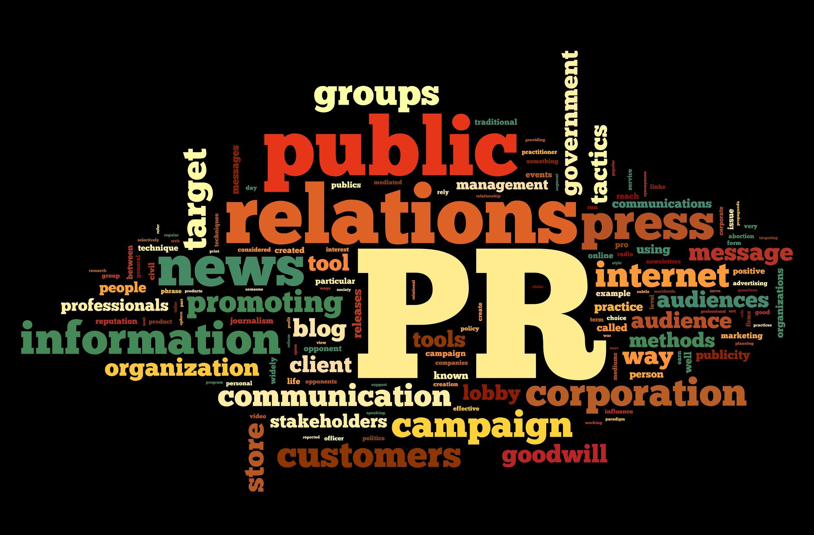

Slide 9
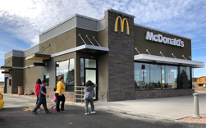
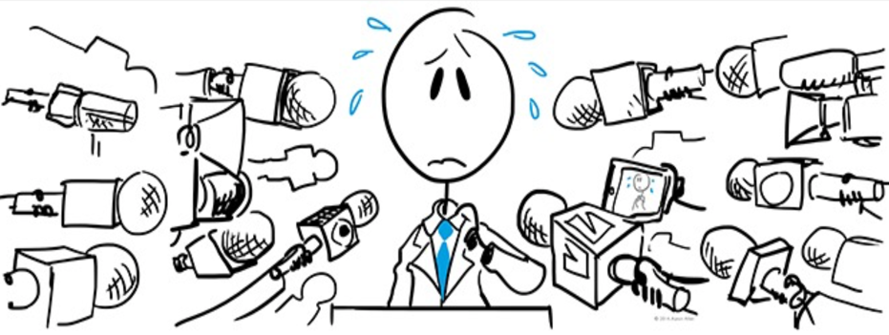
Our Services
example
FPC reaches out to media or inquiry comes in
Media Relations
Media Tours
Strategic Planning
Editorial Database Building & Pitching
Executive Visibility & Thought Leadership
Social Media Management (Editorial)
News Conference Planning & Management
Video Production
Messaging Sessions
Media Training/Speaker Training
Testimonial Programs
Product Launches
Press Kit Development and Writing
Online Newsroom Development
Special Event Planning and Management
Corporate Social Responsibility
Community Relations
Large-scale Stunt Implementation
Internal Communications
Crisis Communications
Sponsorship Programs
Analyst Relations
Award Submissions
Trade Show Research & Support
FPC reaches out to media with response
Restaurant PR at the center of everything!
FPC works w local owners for a story/interview, or if crisis, a statement

Slide 10
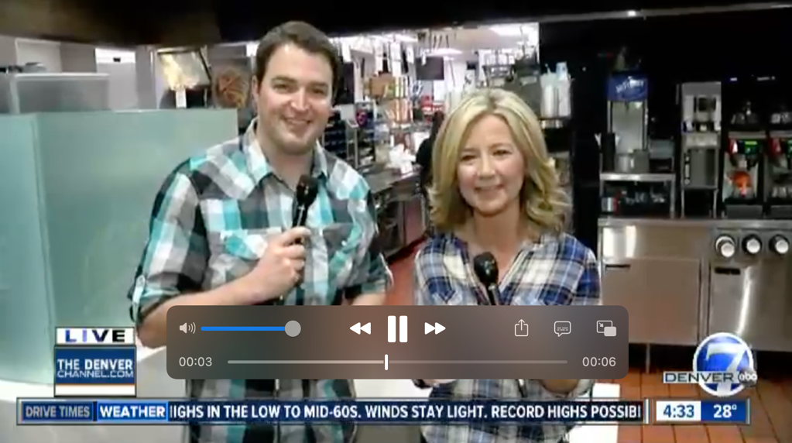
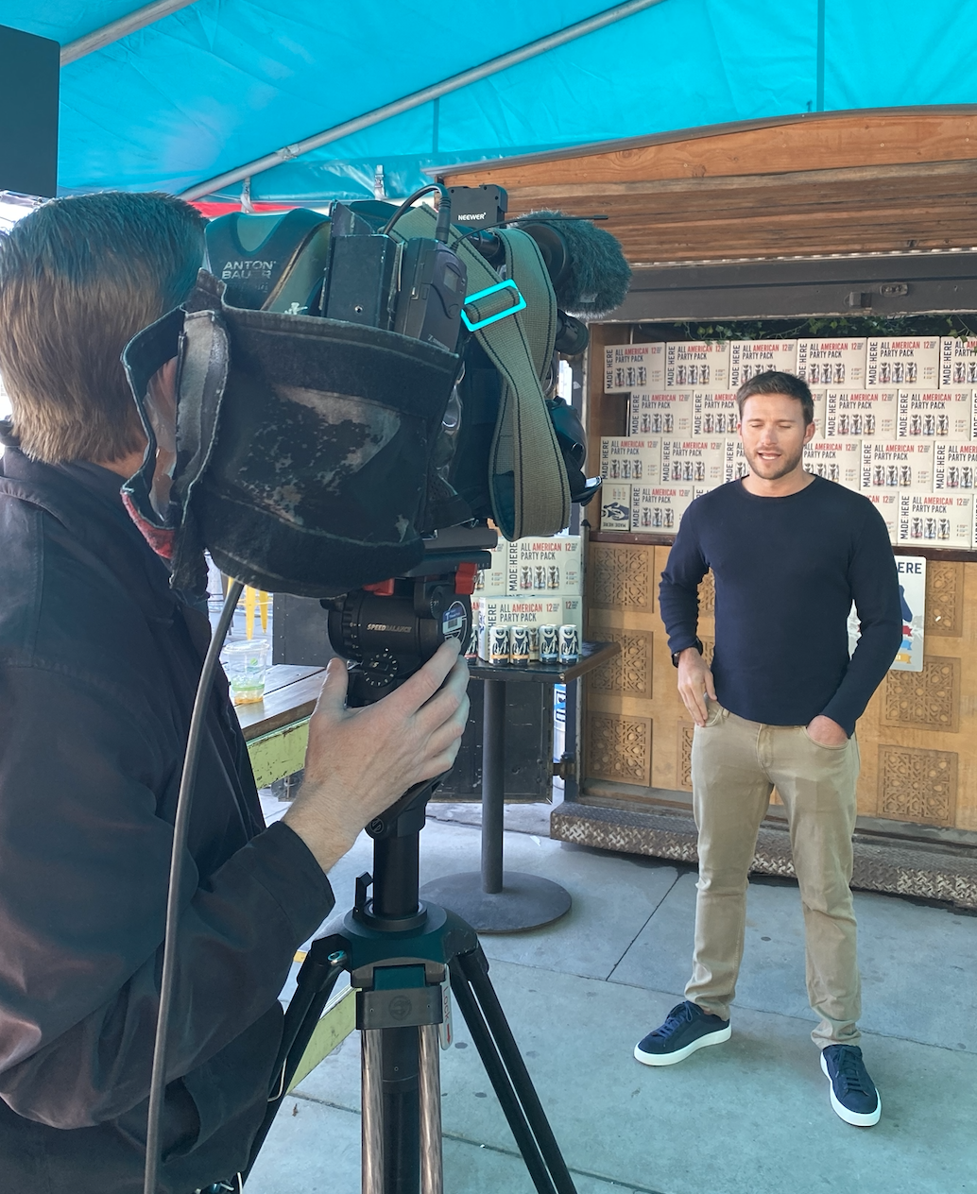
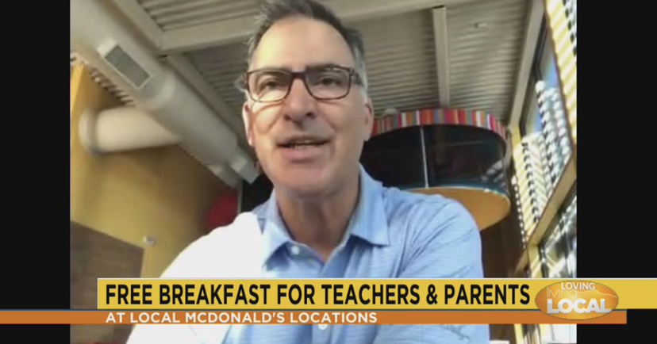
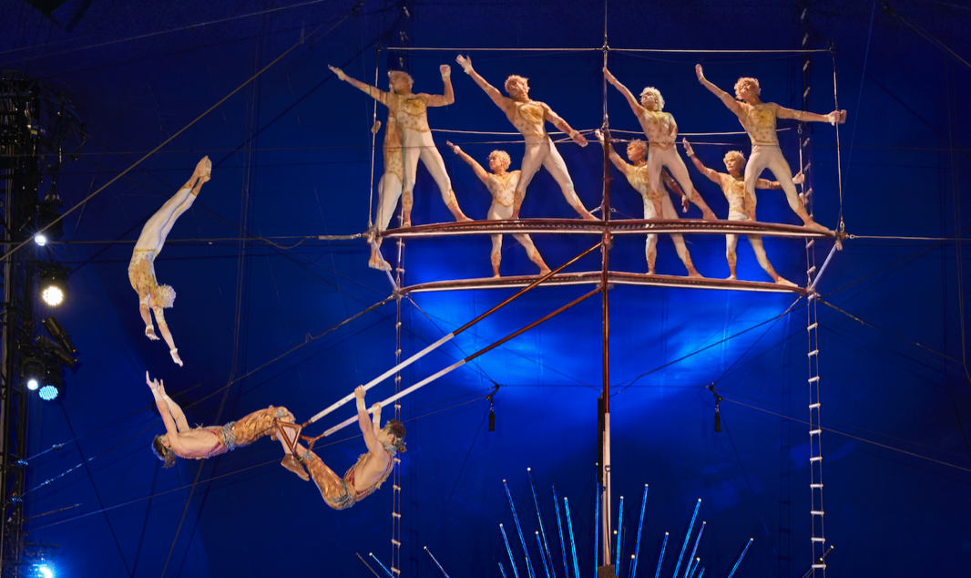
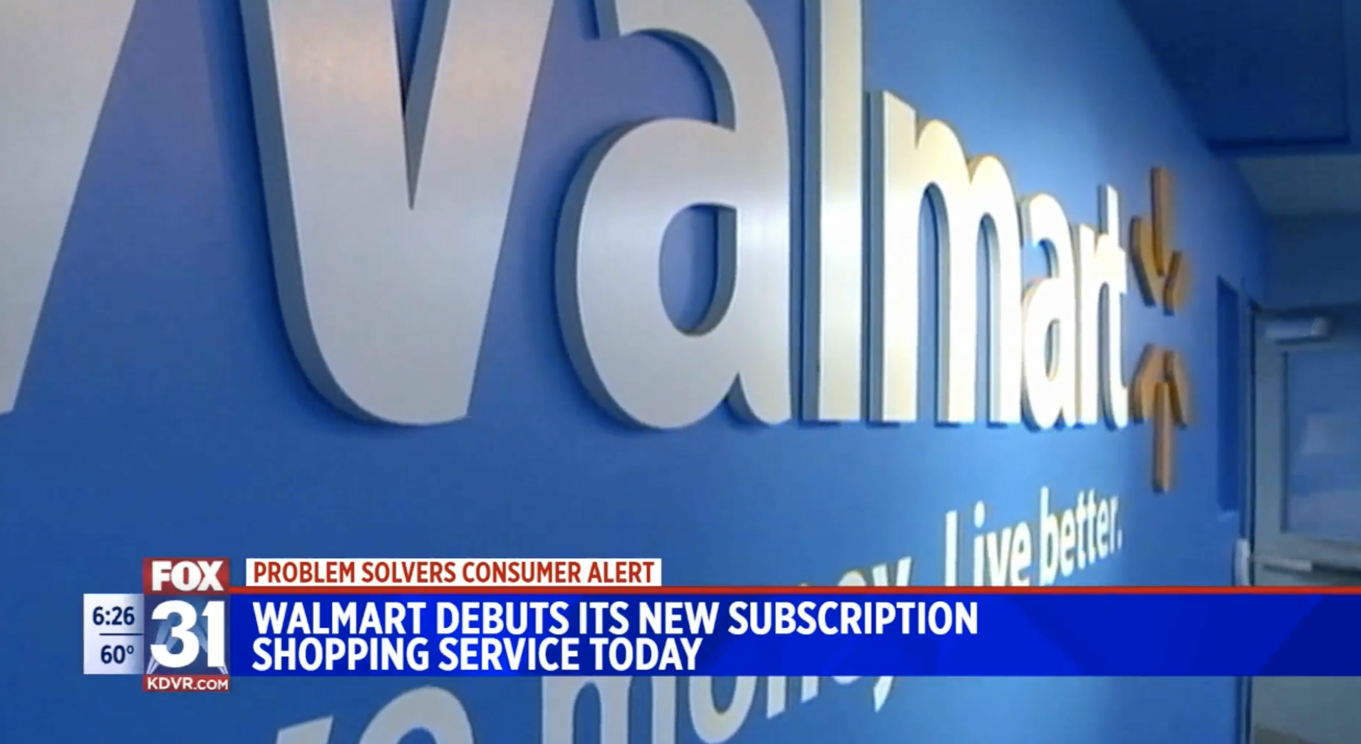
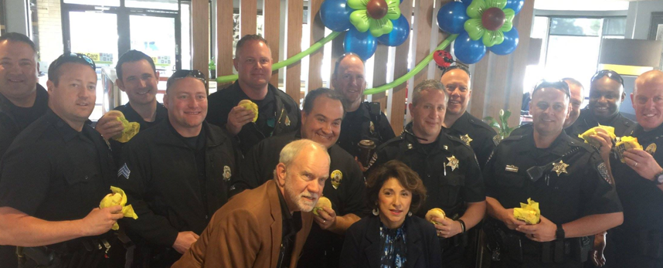
Editorial Media Relations

Slide 11
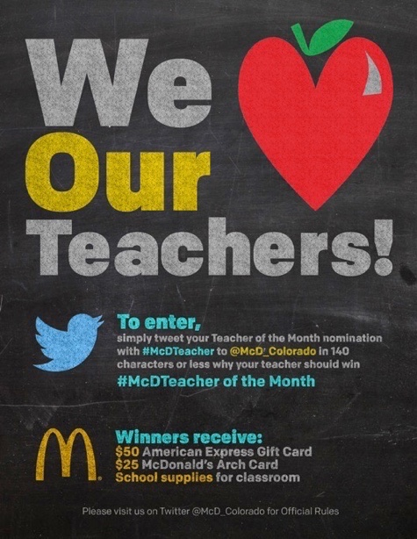
Influencing the Influencers

Slide 12
Types of PR Jobs
In-House/Corporate
Publicist
Agency
Politics
(Campaign Manager/Lobbyist)
Non-Profit

Slide 13
Questions?

