Slide 1
UCSB Comms Alumni Council
Genelle Heim

Slide 2
Agenda
Life
Work
Marketing
Grayson Hayden Group

Slide 3
Life
Grayson Hayden Group

Slide 4
Grayson Hayden Group

Slide 5
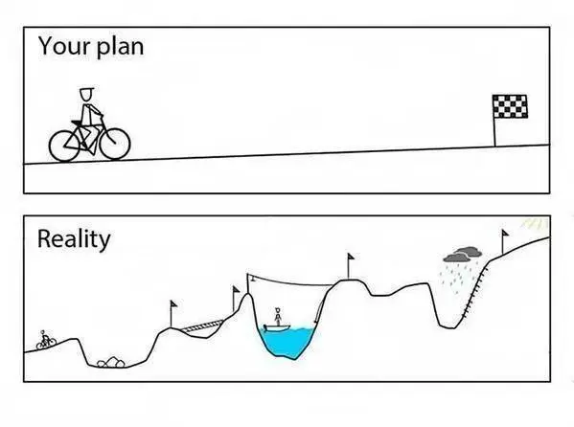
Grayson Hayden Group

Slide 6
Work
Grayson Hayden Group

Slide 7
New Job Hack
1. Meet as many people as you can in the first 30 days
Ask “what advice do you have for me?”
Ask for them for the names of 2 people you should meet with
Repeat
2. Which names keep popping up?
Those are the people who hold influence
3. Follow the money
What groups are getting funded? Sales? Marketing? Product? Research? That’s the group that holds power
Work with them or move into that organization if you can
Grayson Hayden Group

Slide 8
Learn the Business
Every public company has to release “earnings data”. In the US, they have to release this data every quarter. It tells the world how the business is doing.
Listen to the Quarterly Earnings Calls each quarter. Even if you can’t stand listening to the whole call, the first few minutes where the CEO is speaking will give you an overview of what is happening with the company and the business. Listen to what he/she says is going well/poorly and what the “strategy” for the business is.
Grayson Hayden Group

Slide 9
Manage Up
Priority | Project | Due | Supports Goal | Project Size | Status | Notes
1 | Product Webinar | Nov 15 | Demand Gen | L | Green | Registrations have exceeded target
2 | Manager Conference | Dec 10 | Events | M | Yellow | Speaker pulled out
2 | Review Web Copy | Dec 10 | Operating Excellence | M | Red | Julie is on leave so review is taking longer
3 | Conduct Perf Reviews | Dec 15 | Operating Excellence | M | Green
Grayson Hayden Group

Slide 10
Marketing
Grayson Hayden Group

Slide 11
Notes:
Cisco began as a result of Sandy Lerner’s need to check with her husband, Len Bosack, on whether or not he had fed the cats. Sandy and Len worked in different departments at Stanford University, and their email systems were not able to communicate with one another. So Sandy and Len took to their garage and invented the router, enabling the two separate computer networks to communicate, and Cisco Systems was born. Today, Cisco is a $50B company. They worked in their garage after their regular work day was done. The founding story was one based on a real world need to communicate about something very fundamental.

Slide 12
Notes:
Branding and communications efforts should begin with a strategic narrative which is based on the founding story, culture, values and vision of an organization. The narrative is meant to be shared internally and should invoke a visceral “Yes! That is us!” response from employees when they read it.

Slide 13
From the ground up
The strategic narrative becomes the foundation for messages in the “stone tablets”. This framework for marketing and communication messages ensures consistency in brand messaging, regardless of the marketing or communications channel.
Grayson Hayden Group

Slide 14
Stone Tablet Framework
Strategic Narrative (Foundation) |  |  | Strategic Narrative
Key Messages
Product A Narrative | Product B Narrative | Product C Narrative | Product D Narrative
Proof points/ Benchmarks | Proof points/ Benchmarks | Proof points/ Benchmarks | Proof points/ Benchmarks
Case Studies | Case Studies | Case Studies | Case Studies
Customer Testimonials | Customer Testimonials | Customer Testimonials | Customer Testimonials
Compelling brand messaging…
Informs all tactics and execution
Integrated Campaigns/Demand Generation
PR/AR/IR
Web/Social/Digital
Events/Webinars/Tradeshows
Partner Marketing
Employee & Executive Communications
Grayson Hayden Group

Slide 15
Sample Strategic Narrative
At Xilinx, we believe in you, the innovators, the change agents and builders who are developing the next breakthrough idea.
Xilinx is the platform on which your inventions become real. We will get you to market faster, help you stay competitive in an ever-changing world, and keep you at the forefront of your industry.
Grayson Hayden Group
Notes:
Shift thinking to the possibilities and opportunites. Forward thinking. Acknowledge the challeneges but don’t let them stop you or hinder you.

Slide 16
Practical advice
Tell stories
Life is not up and to the right
Black swan events will happen
Manage up
Get a Mentor/Coach
Grayson Hayden Group

Slide 17
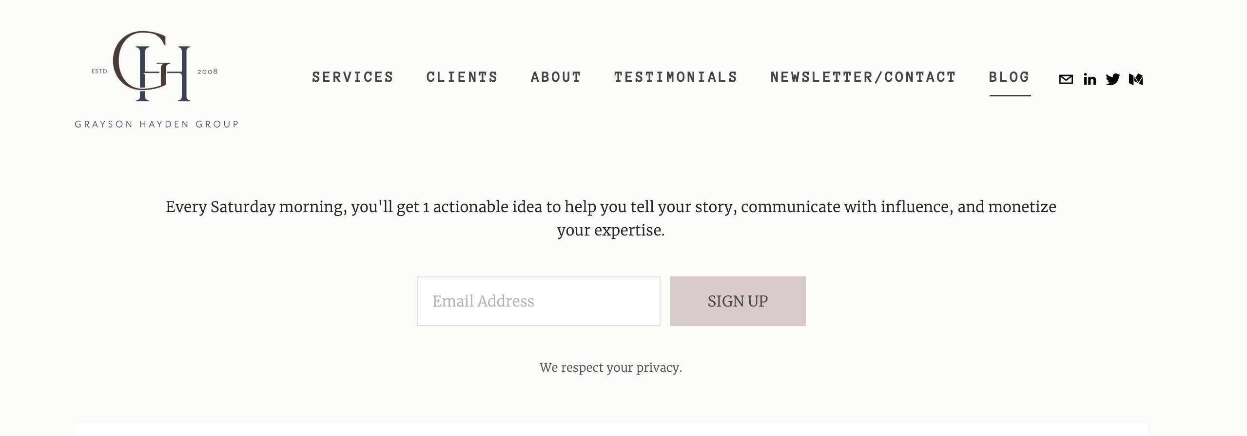
Continue the Conversation
LinkedIn:
https://www.graysonhayden.com/blog
Grayson Hayden Group

Slide 18
GRAYSONHAYDEN.COM

